Slide 1
Online Customers Intention
By:
Arul Vishwakarma
Research Supervisor :
Mr. Srikar Muppidi

Slide 2
Content:
Introduction
Problem Statement
Exploratory Data Analysis
Baseline Solution
Evaluation metrics
Summary of Initial Findings
Challenges
Future Work

Slide 3
Introduction
The increasing popularity of online shopping has led to the emergence of new economic activities.
To succeed in the highly competitive e-commerce environment, it is vital to understand consumer intention.
Understanding what motivates consumer intention is critical because such intention is key to survival in this fast-paced and hypercompetitive environment. Where prior research has attempted at most a limited adaptation of the information system success model, we propose a comprehensive, empirical model that separates the ‘use’ construct into ‘intention to use’ and ‘actual use’.
This makes it possible to test the importance of user intentions in determining their online shopping behavior.
The dataset consists of feature vectors belonging to 12,330 sessions.
The dataset was formed so that each session would belong to a different user in a 1-year period to avoid any tendency to a specific campaign, special day, user profile, or period.

Slide 4
Problem Statement
The task is to predict whether a user in that session is going to buy something from the website (generate Revenue) or not.
Research Papers:
Publications.waset ,
tanfonline.com-Understanding consumer intention in online shopping,
Researchgate.com

Slide 5
Dataset Information
Dataset has 12330 sessions (rows) and 18 attributes (columns).
Number of Attributes:18 (10 continuous; 8 categorical)
Attribute Information:
Continuous:
Attribute 1: Administrative : different values ranging from 0 to 27
Attribute 2: Administrative Duration : different values ranging from 0 to 3398.75
Attribute 3: Informational : different values ranging from 0 to 24.0
Attribute 4: Informational Duration : different values ranging from 0 to 2549.37
Attribute 5: Product Related: different values ranging from 0 to 705.0
Attribute 6: Product Related Duration : different values ranging from 0 to 63973.5
Attribute 7: Bounce Rates: different values ranging from 0 to 0.20
Attribute 8: Exit Rates : different values ranging from 0 to 0.20
Attribute 9: Page Values: different values ranging from 0 to 361.76
Attribute 10: Special Day: different values ranging from 0 to 1.0

Slide 6
Attribute Information:
Categories:
Attribute 1: Month : 10 months (Feb, Mar, May, Jun, July, Aug, Sep, Nov, Dec)
Attribute 2: Operating Systems: 8 categories
Attribute 3: Browser : 13 types of Browsers
Attribute 4: Region: 9 Regions
Attribute 5: Traffic Type: 20 Types of Traffic
Attribute 6: Visitor Type: 3 Types of visitors
Attribute 7: Weekend: Binary (Weekend = True, Not Weekend = False)
Attribute 8: Revenue: Binary (Bought Something = True, Did Not Buy Anything =False)

Slide 7
Dataset Information
Missing Values:
Class Distribution (Target Variable - Revenue):
Numerical Attributes | 0
Categorical Attributes | 0
True | 15.48%
False | 84.52%

Slide 8
Pre – Processing Steps
Deeply Visualizing the data for relational understanding of features
Outliers Treatment
Data Normalization/Transformation
Encoding of Categorical Features
Imbalanced Data Treatment: Up sampling, Down sampling and SMOTE will be tried after Building Base model

Slide 9
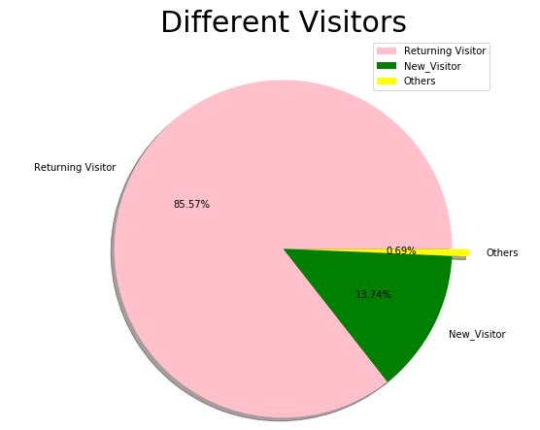
Exploratory Data Analysis Attribute : Visitors Type
This describes the type of customers visiting the website as there are most of the returning customers(regular customers) who are 3/4th of the total.

Slide 10
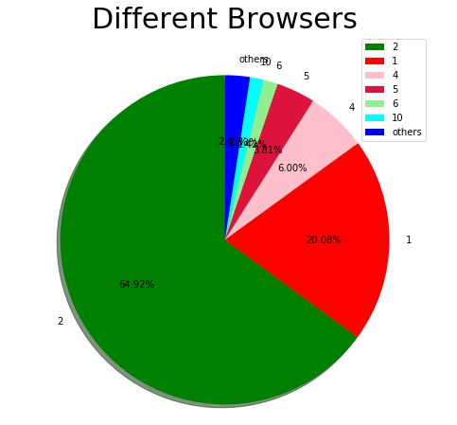
Exploratory Data Analysis Attribute : Browser
Most of the customers uses the same kind of Browser

Slide 11
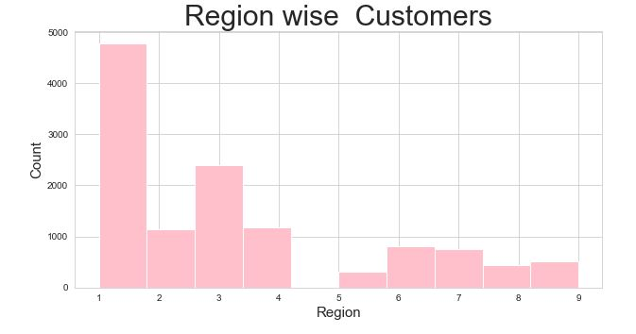
Exploratory Data Analysis Attribute : Region
Most of the customers who visit the website are from region type-1 and none are from region 5

Slide 12
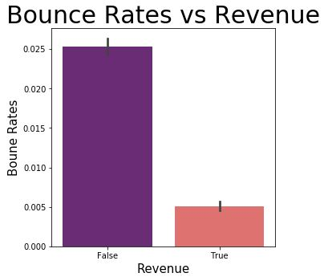
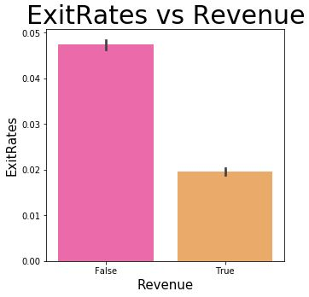
Exploratory Data Analysis Attributes : Page Leaving Rates v/s Revenue
Lesser the bounce rates and exit rates there is a high chance for the customer to make revenue.

Slide 13
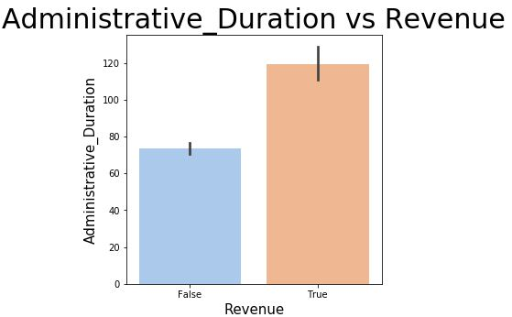
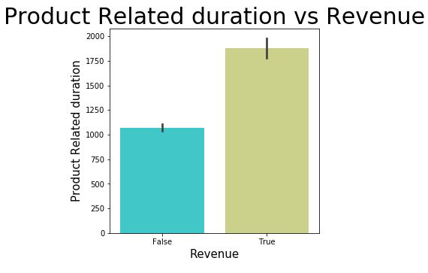
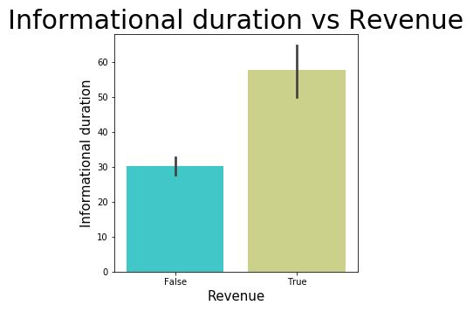
Exploratory Data Analysis Attribute : Durations v/s Revenue
More the time spent on a particular page there is a high chance for the customer to generate revenue.

Slide 14
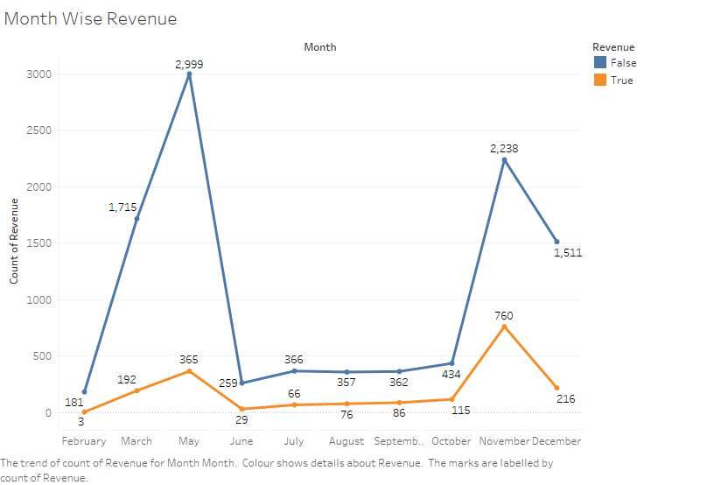
Exploratory Data Analysis Attribute : Month v/s Revenue

Slide 15
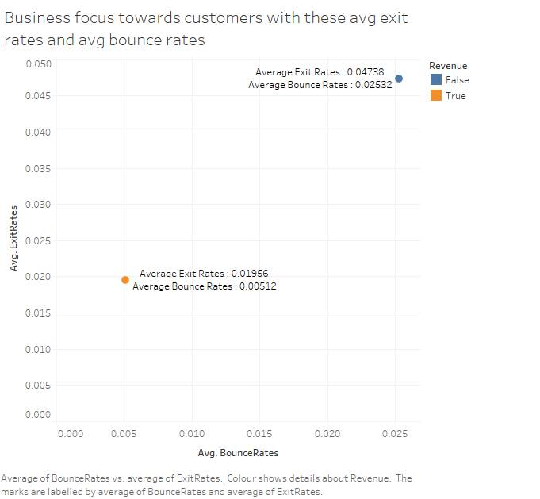
Exploratory Data Analysis Bounce Rate v/s Exit Rate (Checking Revenue generation )

Slide 16
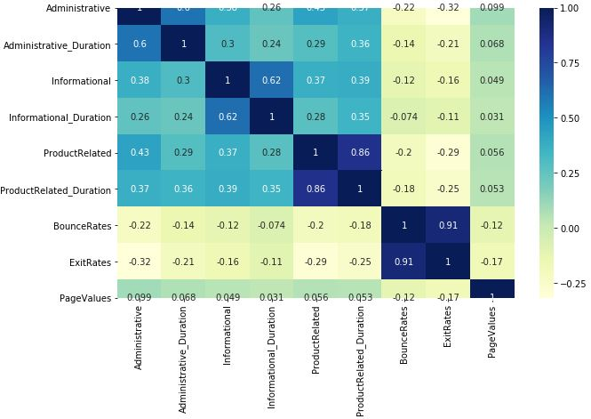
Pearson Correlation Plot
Observation : There is no high correlation between Independent Numerical features apart from
Product Related and Product Related Duration Features are highly correlated

Slide 17
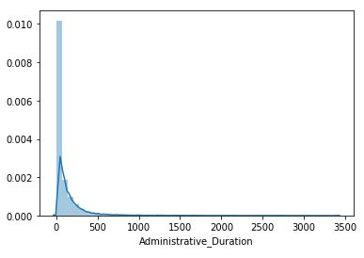
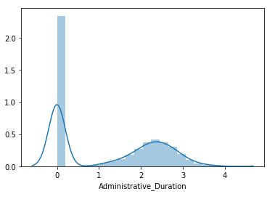
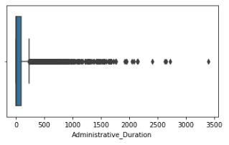
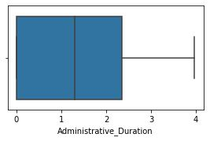
EDA – Transformation
Before
After

Slide 18
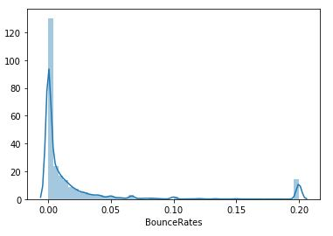
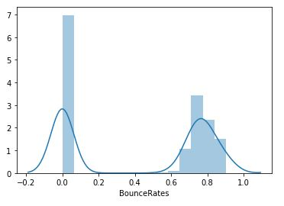
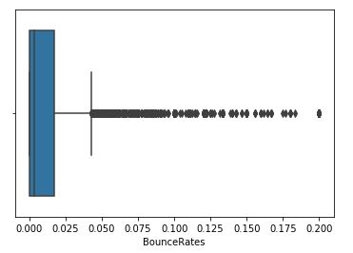
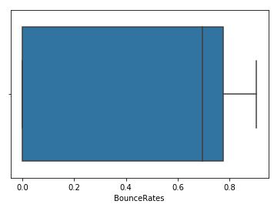
EDA – Transformation
Before
After

Slide 19
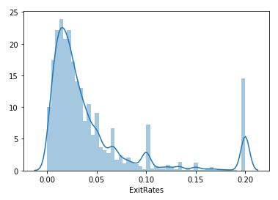
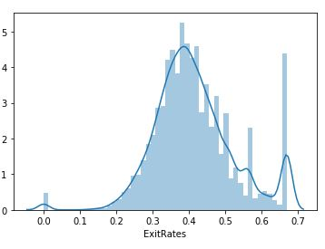
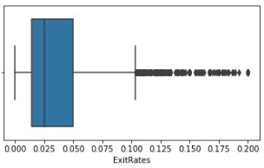
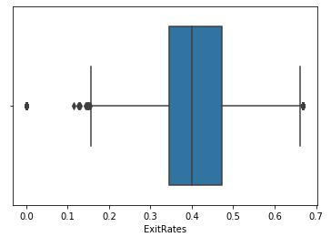
EDA – Transformation
Before
After

Slide 20
Statistical Tests (w.r.t Revenue)
2 Sample T-test
Feature | P-value
Bounce Rates | 1.594197538516729e-63
Exit Rates | 1.6626536250736147e-119
Bounce Rates:
Null Hypothesis : Average Bounce Rate of Users who do not generate revenue(not buy) is same as Average Bounce Rate of users who generate revenue(buy).
Alternate Hypothesis : Average Bounce Rate of Users who do not generate revenue(not buy) is different than Average Bounce Rate of users who generate revenue(buy).
Conclusion: Alternate Hypothesis is True
Exit Rates:
Null Hypothesis : Average Exit Rate of Users who do not generate revenue(not buy) is same as Average Exit Rate of users who generate revenue(buy).
Alternate Hypothesis : Average Exit Rate of Users who do not generate revenue(not buy) is different than Average Exit Rate of users who generate revenue(buy).
Conclusion: Alternate Hypothesis is True

Slide 21
Baseline Model
Algorithm
Logistic Regression algorithm
Properties
Quick and Easy implementation for a Baseline Model building.
Very Easy to Train.
Does not require scaling.
Does not require Hyper-parameter Tuning
Gives out well calibrated predictive probabilities.

Slide 22
Summary of Initial Findings
Accuracy and AUC
Experiment setting
Total samples
False: 10422 sessions
True: 1908 sessions
Train –Test split validation
Training set: 70% examples
Test set: 30% examples
 | Test (%)
Accuracy Score | 88.36%
AUC_ROC | 88.7%
Precision | 75.02%
Recall | 37.1%

Slide 23
Evaluation Metrics
Accuracy and AUC(as per initial baseline model)
Experiment setting :
Total sessions
False: 10422 sessions
True: 1908 sessions
15-fold cross-validation
Average accuracy: 88.9%

Slide 24
Challenges
All Continuous features have outliers which constitutes of about 70% of the total number of sessions recorded.
Meaning of Features namely administrative, Informational and Product Related are ambiguous.
Numerical Features have many 0 values, which makes it difficult to interpret whether 0 is the real value or it is a null value denoted by 0.

Slide 25
Future Work
Future Work
Implementing various classification algorithms for the best model selection
Use Ensemble techniques to improve the model performance
Revisiting Feature engineering /Feature selection process.
Hyperparameter Tuning.
Robust Model Evaluation.
Improving Precision and Recall Scores for Minority class.

Slide 26
Thanks!

